Slide 1

Welcome to the Danish Medicines Agency

Slide 2
From Real World Data to Real World Evidence
When and how can we start using RWD?
Nikolai C Brun, Chief Medical Officer, PhD
Co-Chair of HMA/EMA task force on Big Data

Slide 3
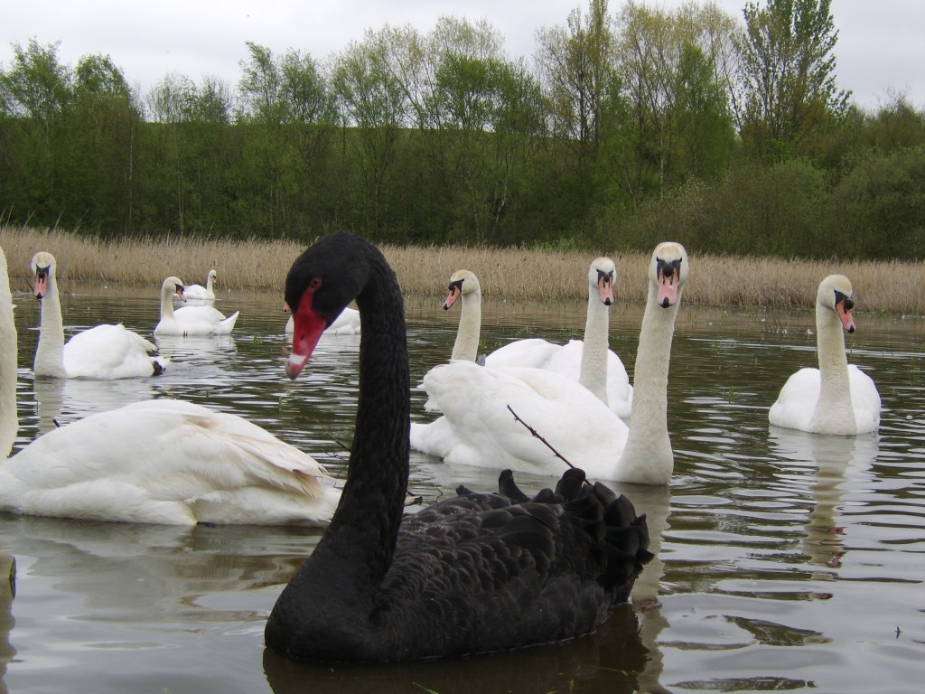

The landscape is changing rapidly – the challenges numerous
Traditionally we have relied on RCTs Randomised double-blind placebo controlled studies for evidence – this is the best way to eliminate bias and get the best source of information on effect/safety of a single intervention/ therapy
The Goal: Effectiveness in the intended target populations is something else, however.
When can we start trusting Big Data based evidence without reverting to 100% empirical thinking?
How can we ensure adequate evidence for regulatory decision making
“No amount of observations of white swans can allow the inference that all swans are white, but the observation of a single black swan is sufficient to refute that conclusion.”
— David Hume (1711-1776)

Slide 4
Today’s agenda:
08.30-09.00: Light breakfast and networking
09.00-09.15: Welcome and introduction
/ Nikolai Brun, Danish Medicines Agency
09.15-09.45: Real World data – from the perspective of the FDA
/ David Martin, FDA
09.45-10.15: Real World data – from the perspective of the industry
/ Robin Evers, Novo Nordisk
10.15-10.40: HMA/EMA Task Force in Europe – challenges, mapping and next steps / Alison Cave, EMA, and Nikolai Brun, Danish Medicines Agency
10.40-11.00: Panel discussion and Q&A
11.00: Thank you for today

Slide 5

Follow us –today is live streamed via Twitter: @DKMA_DK
Snapchat: @laegemiddel
Twitter: @LMSTdk
Facebook, Youtube og LinkedIn: Lægemiddelstyrelsen

