Slide 1
Clinical trial services on DKMAnet
Quick guide for companies

Slide 2
Joint DKMAnet portal for DHMA and research ethics committees
On 24 March 2014, the Danish Health and Medicines Authority and the Scientific Ethical Committee System launched a new version of DKMAnet for companies.
You need only send one application via DKMAnet when you want to apply for a clinical trial or amendments as well as submit documentation related to the safety surveillance or notifications. DKMAnet will send all requests to both the Danish Health and Medicines Authority and the Scientific Ethical Committee System.
DKMAnet will be mandatory at the end of 2014.

Slide 3
All requests concerning clinical trials can be made via DKMAnet

Slide 4
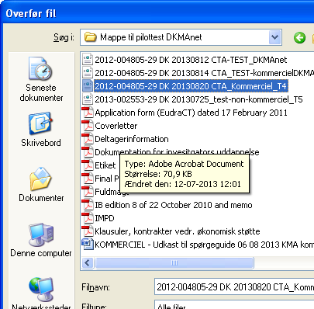
New trials, amendments and notifications require an XML file upload

Slide 5
Fields are automatically filled in with data from the XML file

Slide 6
Information on ethics committees must be filled in manually

Slide 7
Documentation must be attached in PDF format

Slide 8
Max 10 MB per file, max 80 MB in total
Why does the system only allow documents with a file size of maximum 10 MB and applications with a total size of 80 MB?
We have set the limit at 10 MB to avoid that very large files block the system and prevent the submission of applications. This is a common limit in various secure extranet systems.
How do I handle documents with a file size of more than 10 MB?
In the following link you can read about how to reduce the size of your documents.

Slide 9
Choose to whom the amendment or notification is to be sent

Slide 10
Types of amendment to the DHMA

Slide 11
Types of request concerning surveillance

Slide 12
Types of notification

Slide 13
Overview of documents submitted

