Slide 1
Real World Data Use in the U.S.
FDA Perspective
David Martin, MD, MPH
Associate Director for Real World Evidence Analytics
Office of Medical Policy
FDA Center for Drug Evaluation and Research
Danish Medicines Agency – From Big Data to Real World Evidence Meeting
November 20, 2018

Slide 2
Disclosure and Disclaimer
David Martin received funding from the Patient Centered Outcomes Research Trust Fund to develop the FDA My Studies Mobile App
No conflicts of interest to disclose
The views expressed are those of the author and should not be construed as FDA’s views or policies
The mention of commercial products, their sources, or their use in connection with material reported herein is not to be construed as either an actual or implied endorsement of such products by the Department of Health and Human Services

Slide 3

21st Century Cures Expectations
Section 3022 of the Cures Act states:
FDA shall establish a program to evaluate the potential
use of real world evidence (RWE) to support:
  Approval of new indication for a drug approved under section 505(c)
  Satisfy post-approval study requirements
Program will be based on a framework that:
  Categorizes sources of RWE and gaps in data collection
  Identifies standards and methodologies for collection and analysis
  Describes the priority areas, remaining challenges and potential pilot opportunities that the program will address
Framework will be developed in consultation with stakeholders
  Real world evidence means data regarding the usage, or the potential benefits or risks, of a drug derived from sources other than traditional clinical trials

Slide 4
What is a Traditional Clinical Trial?
No single definition of a “traditional clinical trial”
For purposes of 21st Century Cures, propose that a traditional clinical trial is one that has certain hallmark features and includes design and data collection elements
Characterize this as a spectrum

Slide 5
Wide Spectrum of Potential Uses of
RWD / RWE in Clinical Studies
Different Challenges and Opportunities for Each Approach
Randomized Interventional
Interventional non-randomized
Non-randomized / non-interventional
Traditional Randomized Trial Using RWD Elements
Trials in Clinical Practice Settings
Observational Studies
RWD to assess enrollment criteria / trial feasibility
eCRF + selected outcomes identified using EHR/ claims data
Pragmatic RCTs
Prospective data collection
Pragmatic RCT using eCRF (+/- eHR data)
Pragmatic RCT using claims and eHR data
Single arm study using external control
Registry trials/study
Prospective Cohort
Study
Mobile technology
used to capture supportive endpoints (e.g., to assess ambulation)
Using existing databases
RWD to support site selection
Case – Control
Retrospective Cohort Study (HC)
Increasing reliance on RWD
Traditional RCT
RWE / pragmatic RCTs
Courtesy of Peter Stein, OND
Observational cohort

Slide 6
CDER Definitions
Real-World Data (RWD) are data relating to patient health status and/or the delivery of health care routinely collected from a variety of sources.
Real-World Evidence (RWE) is the clinical evidence regarding the usage and potential benefits or risks of a medical product derived from analysis of RWD.
RWD include data derived from electronic health records (EHRs), claims and billing data, data from product and disease registries, patient-generated data including in home-use settings, and data gathered from other sources that can inform on health status, such as mobile devices.
RWE can be generated by different study designs or analyses, including but not limited to, randomized trials, such as large simple trials, pragmatic trials, and observational studies (prospective and/or retrospective ).

Slide 7
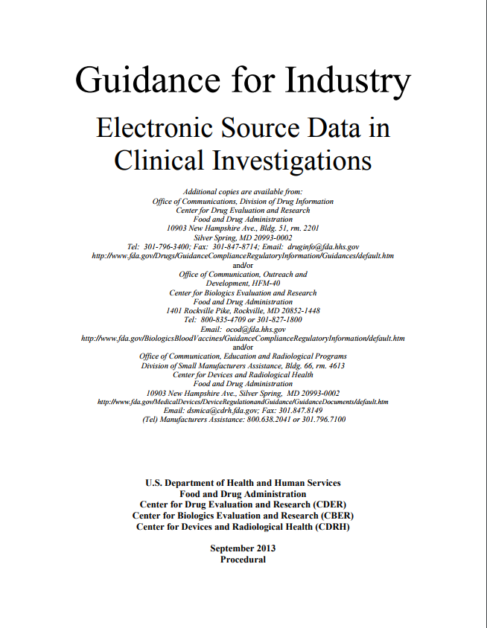
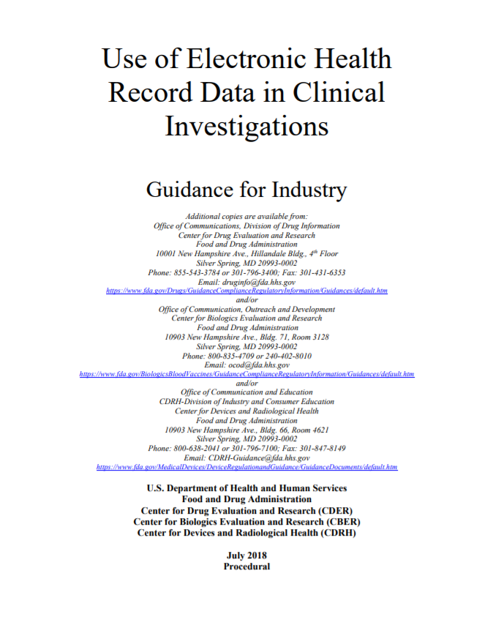
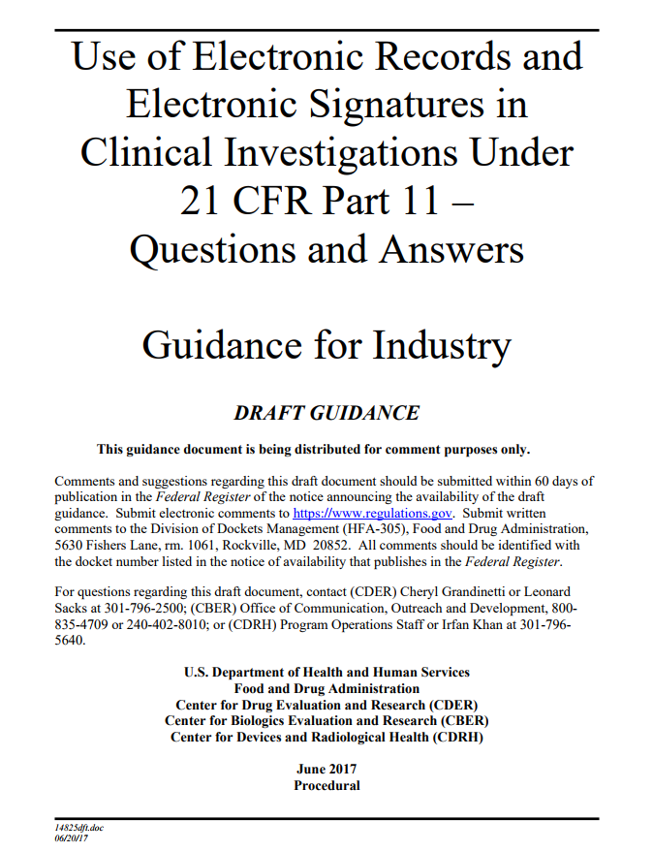
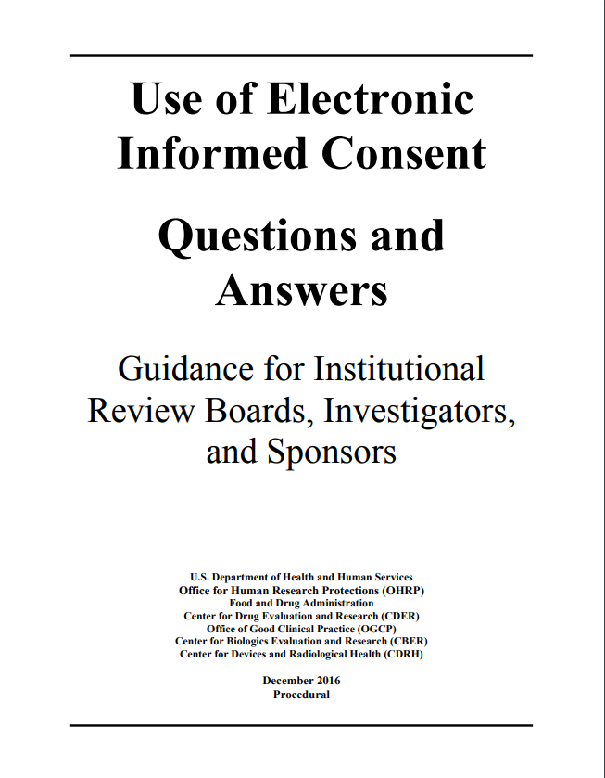
Foundation for use of Electronic Data

Slide 8
RWE: What are the Goals?
Maximize the opportunities to incorporate data/evidence from settings that are more reflective of clinical practice into regulatory decisions
    Increase the diversity of populations
    Improve efficiencies
    Population identification/selection
    Reduce duplicative capture of data
  Fill current evidence gaps
  While at the same time
Maintaining current evidentiary standards

Slide 9
Establishing Effectiveness
Section 505 (d) of the Food Drug and Cosmetic Act requires adequate and well controlled investigations, including clinical investigations, on the basis of which it could fairly and responsibly be concluded by such experts that the drug will have the effect it purports or is represented to have under the conditions of use prescribed, recommended, or suggested in the labeling or proposed labeling thereof.
For drugs to treat life-threatening and severely debilitating diseases, FDA has determined that it is appropriate to exercise the broadest flexibility in applying the statutory standards, while preserving appropriate guarantees for safety and effectiveness. 21 CFR 312.80

Slide 10
Benchmark
Substantial evidence standard unchanged
  Goal is to distinguish the effect of the drug from other influences such as spontaneous change in disease course, placebo effect, or bias
  Routine practices
    Probabilistic control of confounding through randomization
    Blinding
    Controlled/Standardized outcome assessment
    Adjudication criteria
    Audits

Slide 11
The Current State
Considerable experience working with claims and pharmacy data to generate evidence about safety of products
More limited use of RWD in efficacy determinations, with a focus on rare diseases and cancers
Recognition that current system provides substantial evidence of effectiveness in the population studied but may leave a number of questions unanswered
Multiple stakeholders are actively working on identifying when and how RWE can fill in the gaps

Slide 12
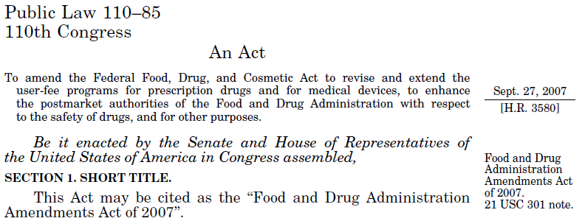

2007 FDA Amendments Act (FDAAA)
Post Marketing Requirements
Safety Labeling Changes
Risk Evaluation and Mitigation Strategies (REMS)
Required Safety Reviews (“915” and “921”)
Active post-market Risk Identification and Analysis system
  FDA Sentinel Initiative

Slide 13
Active Risk Identification and Analysis (ARIA) System
Mandated creation in Section 905 of FDAAA 2007
Linked to PMR in Section 901(3)(D)(i):
  “The Secretary may not require the responsible person to conduct a study under this paragraph, unless the Secretary makes a determination that the reports under subsection (k)(1) and the active postmarket risk identification and analysis system as available under subsection (k)(3) will not be sufficient to meet the purposes set forth in subparagraph (B).”
https://www.gpo.gov/fdsys/pkg/PLAW-110publ85/pdf/PLAW-110publ85.pdf

Slide 14
Defining ARIA
ARIA uses a subset of Sentinel System’s full capabilities to fulfill the FDAAA mandate to conduct active safety surveillance
Analytic Tools*
Common Data Model†
ARIA
* Pre-defined, parameterized, and re-usable to enable faster safety surveillance in Sentinel (in contrast to protocol based assessments with customized programming)
† Electronic claims data, without manual medical record review

Slide 15
What is Sufficiency?
Adequate data
  Drug/biologic of interest and comparator
  Confounders and covariates
  Health outcome of interest
Appropriate methods
To answer the question of interest
  assess a known serious risk related to the use of the drug/biologic
  assess signals of serious risk related to the use of the drug/biologic
  identify an unexpected serious risk when available data indicate the potential for a serious risk
To lead to a satisfactory level of precision

Slide 16
When are automated queries sufficient?
General approaches
  Determination of sufficiency occurs in context of study question and overall regulatory objective
  Assessment of known risks or risks with substantial existing information typically require higher level of certainty
  Assessments that aim to improve current safety knowledge when little is known may have less stringent requirements
First 2 years of ARIA^
  Total of 89 Drug-AE pairs assessed
    44 (49%) Drug-AE pairs sufficient
    45 (51%) Drug-AE pairs insufficient
^1/2016-2/2018; preliminary data

Slide 17
When are automated queries insufficient?
45 Drug-AE pairs insufficient^
Reasons for Insufficiency*
  Study population = 25
  Exposure = 11
  Outcome = 38
  Covariate = 10
  Analytic tool = 12
^1/2016-2/2018 – first 2 years of ARIA; preliminary data
*Total = 96 (some drug-AE pairs have more than one reason for insufficiency)

Slide 18



Historical Controls Often
Used in Rare Diseases
Drug
Indication
Status
Data source
Voraxaze
(glucarpidase)
Treatment of MTX toxicity
Approved
2012
Approval based on open-label, NIH compassionate Use Protocol
Uridine
Triacetate
Treatment of 5 FU overdose
Approved
2015
Two single-arm, open label expanded access trial of 135 patients compared to case history control
Brincidofovir
Treatment of Ebola
Phase II ongoing
Non-random open label single arm trial with historical and contemporary controls with multi-stage trial design
Treatment of NAGS deficiency
Approved 2010
Retrospective, non-random, un-blinded case series of 23 patients compared to historical control group
Treatment of Pompe disease
Approved 2004
Open-label, non-randomized study of 18 patients compared to historical control group of 62 untreated patients
Anti-coagulation in heparin-induced thrombocytopenia
Approved 1998
Two non-randomized, open-label multicenter trials using historical control comparator group from chart review
Treatment of methanol or ethylene glycol poisoning
Approved 1997
2 open-label, uncontrolled studies with historical control dating back to 1946 collected from chart reviews
Ucephan
Treatment of urea cycle disorder
Approved 1987
Multi-center open-label, non-randomized study of 56 patients compared to survival rates of untreated historical controls
NOT EXHAUSTIVE
Bold = RWE
Treatment of NAGS deficiency
Approved 2010
Retrospective, non-random, un-blinded case series of 23 patients compared to historical control group
RWD use in Efficacy - Precedent but not Pervasive
Treatment of Pompe disease
Approved 2004
Open-label, non-randomized study of 18 patients compared to historical control group of 62 untreated patients
Anti-coagulation in heparin-induced thrombocytopenia
Approved 1998
Two non-randomized, open-label multicenter trials using historical control comparator group from HIT Registry
Treatment of methanol or ethylene glycol poisoning
Approved 1997
2 open-label, uncontrolled studies with historical control dating back to 1946 collected from chart reviews

Slide 19
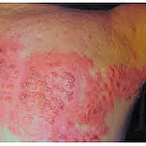
MERCK Zostavax for Herpes Zoster
Pre-approval efficacy trials
Shingle Prevention Study (SPS) -
  Double-blind, placebo-controlled (DBPC) RCT 38,546 individuals > 60
  Median follow-up 3.1 years - reduction in risk of developing HZ 51% across all ages
ZOSTAVAX Efficacy and Safety Trial (ZEST)
  DBPC RCT of 22,439 individuals 50-59 years of age
  Median follow-up 1.3 years - reduction in risk of developing HZ incidence 69.8%
Post Marketing Commitment to study long-term efficacy in ages 50-59
  Prospective observational study run by Kaiser Permanente Northern California
  Data on > 1.3 million members 50 years and older, with over 390,000 individuals who received Zostavax and 100,000 individuals with more than 5 years follow up post vaccination
  Section 14 – Clinical Studies-Updated: Vaccine effectiveness (VE) against HZ for 50-59 over first 3 years following vaccination and for individuals > 60 over five years

Slide 20
Incorporating RWE Into
Evidence Generation
Many factors must be considered at the same time
Regulatory Question
Methods/Design
RWD
Efficacy or safety
Relationship to available evidence
Clinical context – rare, severe or life-threatening, unmet need
Nature of endpoint/ concerns about bias
Relevancy
Validation
Quality Assurance/Control
33
FDA Guidance- Best Practices for Conducting and Reporting Pharmacoepidemiologic Safety Studies Using Electronic Healthcare Data, 2013

Slide 21
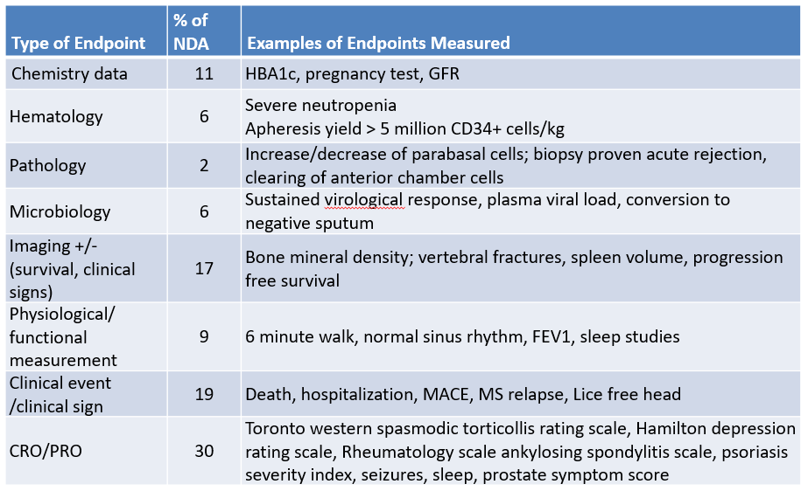
Endpoints in FDA Registrational trials
2007-2015

Slide 22
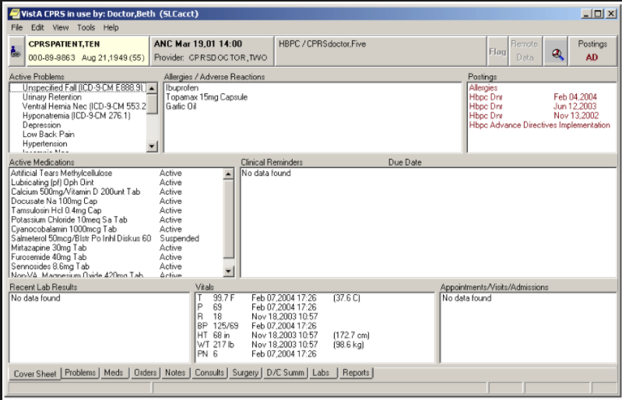
EHR Data Likely Key for Regulatory RWE
While EHR data have advantages of:
  Presenting a more complete and granular clinical picture
  Including labs/imaging/pathology reports
Challenges include:
  Data in pathology/ radiology and clinical notes are often unstructured (80%)
  Typical does not = consistency/ complete documentation
  Clinical outcome measures for drug approvals may not be used or consistently recorded in practice

Slide 23


Understanding Data Curation
Structured Data
=
Standardized Data
?
Mark Nagy, VP, Global Patient Outcomes and Real World Evidence at Eli Lilly & Co. pointed out the difficulty in obtaining specific information in datasets. His team found that in one dataset there were 1,000 different ways HBA1C was being reported.

Slide 24
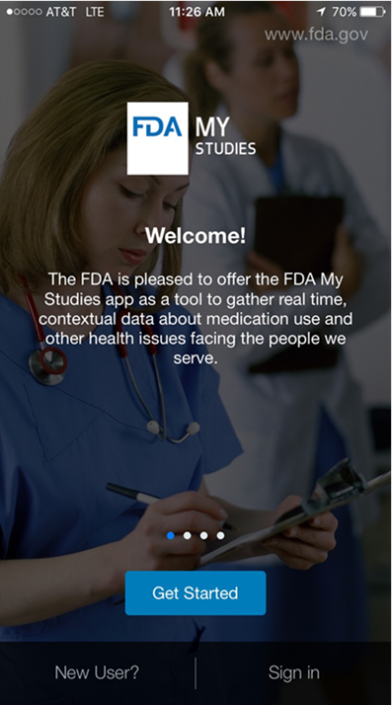
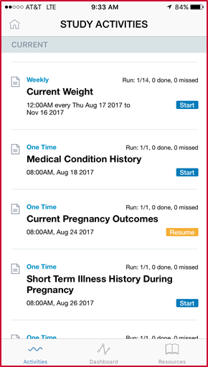
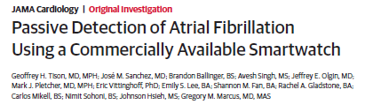
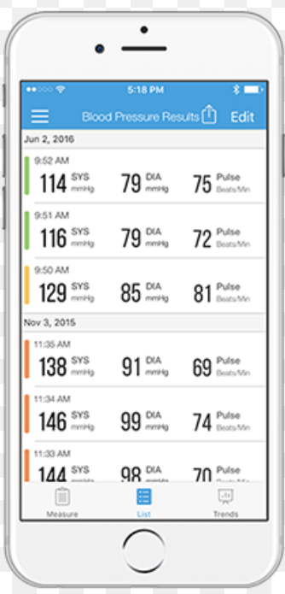
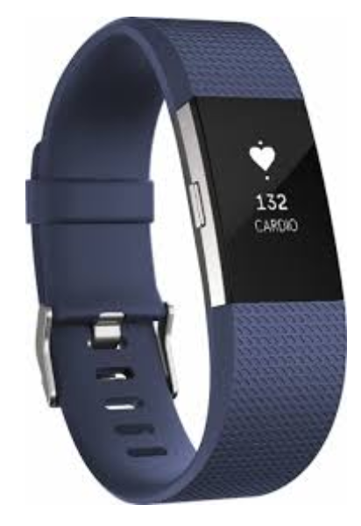
Patient Centric RWE may require more than Health Care Records

Slide 25
Three Big Opportunities with Demonstration Projects
Expand the quantity, quality, and diversity of RWD
  Broaden the range of RCT endpoints that can be captured
  Increase statistical power
  Reduce the number of unmeasured confounders
  Engage with patients through mobile technology
Gain practical experience with “Real World” randomized designs and registries
  Inform regulatory considerations
Assess the performance of non-interventional designs
  “Pressure test” widely accepted designs
  Consider new paradigms

Slide 26


Observational Designs for Efficacy?

Slide 27
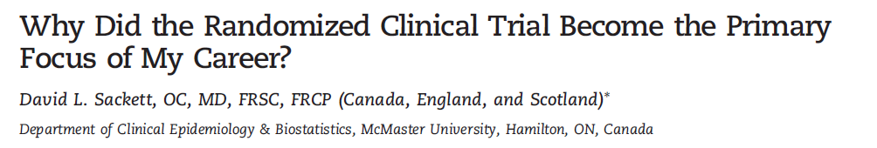

Clinicians might preferentially give new treatments to patient with better prognosis
Compliant patients might have better prognosis, regardless of their treatment
Patients who liked their Rx might report better outcomes unrelated to the true efficacy of their treatments
Clinicians who like their RX might report spuriously better outcomes among patients who receive them

Slide 28
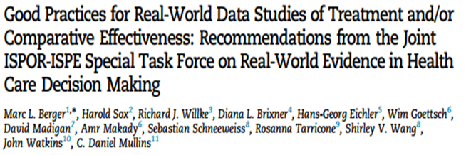
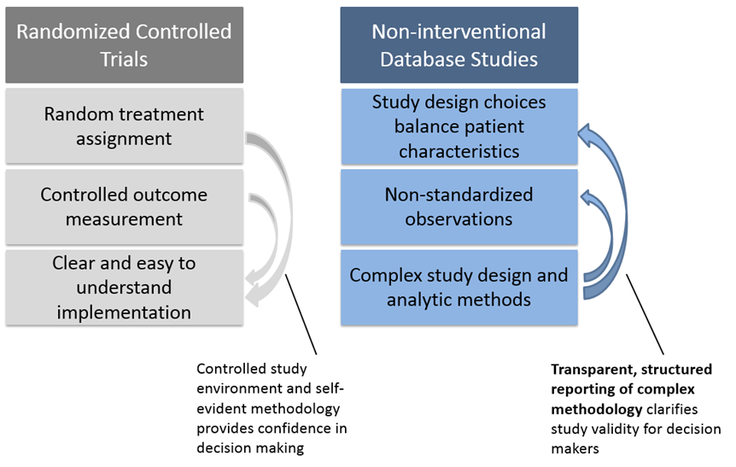
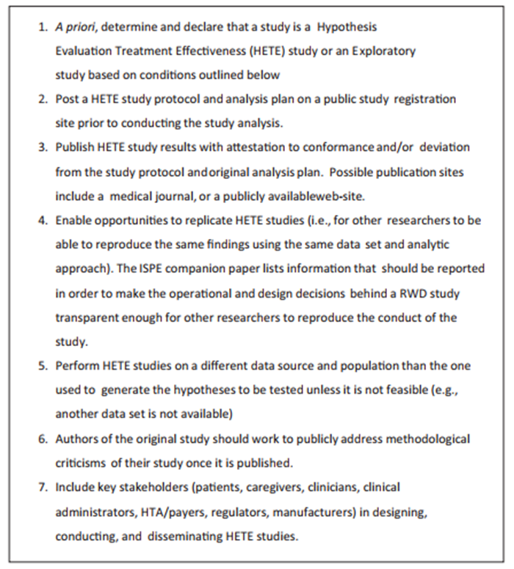
Efforts to Enhance Transparency

Slide 29
Demonstration Project-
Assessment of Non-Interventional
Designs
High throughput replication of phase 3 & 4 RCTs over three years to provide empirical evidence base to inform the potential level of confidence in high quality non-interventional designs
FDA reviewers and researchers from the BWH/HMS Division of Pharmacoepidemiology jointly
  Selected 40 trials in which claims data are sufficiently fit for purpose in a research environment
    Oral hypoglycemic, novel oral anticoagulant, antiplatelet, antihypertensive, anti-osteoporosis, asthma, COPD, heart failure, anti-arrhythmic, and lipid lowering medications
  Concurred with pre-specified measures of agreement
  Reviewed an implementation process
Goal: 30 trials completed by March 2020

Slide 30
Implementation Process
Prospective engagement with FDA during protocol development and initial feasibility and power calculations
FDA review of final definitions of cohort identification, exposure, outcome, and covariates
While blind to differential outcome, final power analyses and covariate balance checks are completed – joint go/no go decision
Study protocol registered on ClinicalTrials.gov
Analyze outcome data and calculate effect measures
Document findings
Apply prespecified measures of agreement
Audit trail visible to FDA throughout the process – FDA sub-team may at its option engage in additional post-hoc sensitivity analyses for training purposes

Slide 31
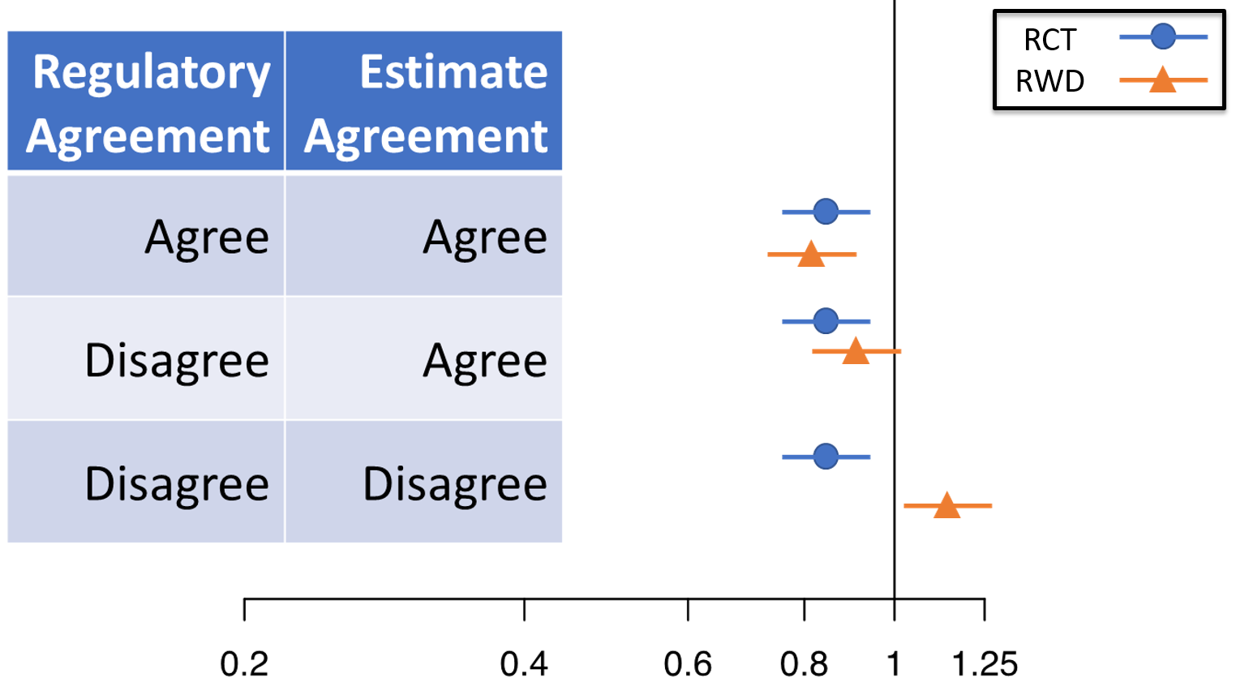
Evaluating Agreement
“Regulatory Decision” Agreement (RA): RWD study would have come to the same conclusion as RCT based on statistical significance of effect estimate.
  Same significance finding (reject / do not reject H₀)
  Same non-inferiority margin required when applicable
Estimate Agreement (EA): RWD effect estimate lies within the 95% CI from the RCT.

Slide 32
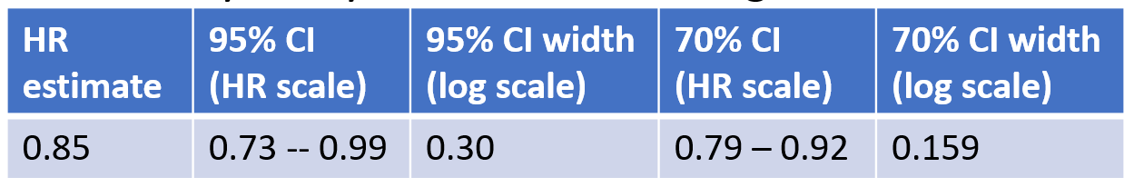
Evaluating Agreement:
Prespecified Sensitivity Analyses
“Regulatory Decision” Agreement (RA)
  Agreement is more likely when RCT effect is large
  Sensitivity analysis: Evaluate RA stratified by the RCT p-value (strong significance: <0.01, borderline significance: 0.01-0.1, non-significance: > 0.1).
Estimate Agreement (EA):
  If RCT 95% CI is wide, then EA does not identify whether studies are in close agreement.
  Sensitivity analysis: Assess EA using a 70% CI.

Slide 33
Next Steps
Learn from relevant submissions
Continue demonstration projects and public engagement
Framework and guidance development specified in 21st Century Cures

Slide 34
Questions
CDERMedicalPolicy-RealWorldEvidence@fda.hhs.gov

Slide 35
Acknowledgements
Jacqueline Corrigan-Curay
Khair ElZarrad
Peter Stein
David Martin
Dianne Paraoan
Robert Ball
Michael Nguyen

