Slide 1





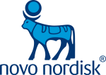

Novo Nordisk
Real World Evidence – an industry perspective
Robin Evers
Senior Vice President
Medical Affairs, Regulatory and Safety
20 November 2018
OVER 175
RWE STUDIES
Novo Nordisk - Corporate Presentation
1
2017 R&D spend
~1.8 BILLION EUR
OBESITY
EMPLOYS APPROXIMATELY
43,000 PEOPLE
5 STRATEGIC PRIORITIES
Diabetes
Obesity
Haemophilia
Growth disorders
Other serious chronic diseases
DIABETES
UP TO
40,000 PATIENTS
IN CLINICAL TRIALS
GROWTH DISORDERS
SUPPLIER OF NEARLY
HALF OF THE
WORLD’S INSULIN
27,700,000
PEOPLE USE OUR
DIABETES CARE PRODUCTS
HAEMOPHILIA

Slide 2
Forward-looking statements
Novo Nordisk’s reports filed with or furnished to the US Securities and Exchange Commission (SEC), including this presentation as well as the company’s statutory Annual Report 2017 and Form 20-F, which are both filed with the SEC in February 2018 in continuation of the publication of the Annual Report 2017, and written information released, or oral statements made, to the public in the future by or on behalf of Novo Nordisk, may contain forward-looking statements. Words such as ‘believe’, ‘expect’, ‘may’, ‘will’, ‘plan’, ‘strategy’, ‘prospect’, ‘foresee’, ‘estimate’, ‘project’, ‘anticipate’, ‘can’, ‘intend’, ‘target’ and other words and terms of similar meaning in connection with any discussion of future operating or financial performance identify forward-looking statements. Examples of such forward-looking statements include, but are not limited to:
Statements of targets, plans, objectives or goals for future operations, including those related to Novo Nordisk’s products, product research, product development, product introductions and product approvals as well as cooperation in relation thereto,
Statements containing projections of or targets for revenues, costs, income (or loss), earnings per share, capital expenditures, dividends, capital structure, net financials and other financial measures,
Statements regarding future economic performance, future actions and outcome of contingencies such as legal proceedings, and
Statements regarding the assumptions underlying or relating to such statements.
These statements are based on current plans, estimates and projections. By their very nature, forward-looking statements involve inherent risks and uncertainties, both general and specific. Novo Nordisk cautions that a number of important factors, including those described in this presentation, could cause actual results to differ materially from those contemplated in any forward-looking statements.
Factors that may affect future results include, but are not limited to, global as well as local political and economic conditions, including interest rate and currency exchange rate fluctuations, delay or failure of projects related to research and/or development, unplanned loss of patents, interruptions of supplies and production, product recalls, unexpected contract breaches or terminations, government-mandated or market-driven price decreases for Novo Nordisk’s products, introduction of competing products, reliance on information technology, Novo Nordisk’s ability to successfully market current and new products, exposure to product liability and legal proceedings and investigations, changes in governmental laws and related interpretation thereof, including on reimbursement, intellectual property protection and regulatory controls on testing, approval, manufacturing and marketing, perceived or actual failure to adhere to ethical marketing practices, investments in and divestitures of domestic and foreign companies, unexpected growth in costs and expenses, failure to recruit and retain the right employees, and failure to maintain a culture of compliance.
For an overview of some, but not all, of the risks that could adversely affect our results or the accuracy of forward-looking statements in this presentation, reference is made to the overview of risk factors in ‘The Risks of Doing Business’ on pp 40-43 of the Annual Report 2017.
Unless required by law, Novo Nordisk is under no duty and undertakes no obligation to update or revise any forward-looking statement after the distribution of this presentation, whether as a result of new information, future events or otherwise.
Important drug information
Victoza® (liraglutide 1.2 mg & 1.8 mg) is approved for the management of type 2 diabetes only
Saxenda® (liraglutide 3 mg) is approved in the US and EU for the treatment of obesity only

Slide 3
RWE covers a wide range of studies based on a large toolbox of data sources
RCTs
Part of regulatory files
Part of regulatory files
Not part of regulatory files
Not part of regulatory files
Pragmatic clinical trials
Pragmatic clinical trials
Database studies
Database studies
Non-interventional studies
Non-interventional studies
Surveys and chart reviews
Surveys and chart reviews
RCTs and RWE should be used complementarily

Slide 4
Industry is engaged in RWE studies
& RWEs are normally post-approval, with exceptions
Pre-approval pragmatic RWE
The Salford Lung Study (GlaxoSmithKline)¹
Population: Patients with chronic obstructive pulmonary disease
Number of patients: 2,799
Setting: 75 general practices
Treatment: fluticasone furoate–vilanterol vs usual care
Primary objective: rate of moderate or severe exacerbations
Secondary objective: rate of primary care contact and secondary care contact
Methods: electronic health records information and “undisturbed” routine clinical care
Post-approval large-scale CV RWEs
CVD-REAL (Astra Zeneca)¹
Population: T2D patients
Number of patients: 309,056
Treatment: New users of SGLT2 inhibitors
Primary objective: hospitalization for heart failure and death
Comparative Effectiveness of Empagliflozin in the US (Boehringer Ingelheim)²
Population: T2D patients
Estimated enrolment: 80,000
Treatment: SGLT2 inhibitor Empagliflozin
Primary objective: all-cause mortality, heart failure, major cardiovascular events
1) Vestbo et al, NEJM, 2016, 375, 13.
1) Kosiborod M et al. Circulation 2017;136:249–259
2) https://clinicaltrials.gov/ct2/show/NCT03363464, accessed January 2018.

Slide 5
Novo Nordisk uses different types of RWE studies
5
Retrospective studies
Prospective studies
Survey
Chart review
Database study
Non-
interventional study
Pragmatic trial
Physician survey¹
(Insulin degludec)
EU-TREAT
(Insulin degludec)²
EXTRA (IDegLira)³
EXPLORYS, US (Insulin degludec)⁴
Maccabi, IL
(Insulin degludec)⁵
REFLECT®
(Insulin degludec)⁶
EVIDENCE® (Liraglutide)⁷
LIRA PRIME (Liraglutide)⁸
DUAL VIII (IDegLira)⁹
RWE: real world evidence; IDegLira: Insulin degludec /liraglutide fixed combination
1. Harashima et al. Expert opinion on Pharmacotherapy 2016,5-11; 2. Siegmund et al. Diabetes Obs. Metab. 2018, 20 (3): 689-697; 3. Price et al. Diabetes Obes Metab. 2018;20(4):954-962; 4. Tibaldi et al. Diabetes 2018, Jul; 67
(Suppl. 1); 5. Cohen C et al. Diabetes Ther. 2017 Oct;8(5):1047-1055; 6. Data on file; 7. Gautier et al. Adv Ther. 2015 Sep;32(9):838-53 ; 8. Unger et al. Diabetes 2018 Jul; 67(Suppl. 1); 9. https://clinicaltrials.gov/ct2/show/NCT02501161

Slide 6

Novo Nordisk examples of RWE use in regulatory decision making
1
Rare disease
Used patient registry to collect safety and efficacy information to support new indication and label update
2
Diabetes product
Use in combination with other products; RCT evidence combined with RWE evidence to demonstrate safety and used in combination with a boarder use of concomitant medications
3
Diabetes product
Evidence from RCTs, Electronic Medical Records (EMR) and RWE study supported use of new product in an earlier line of treatment

Slide 7
Real-world data completes the evidence base for degludec
N=11000^{1,2}
Randomised controlled trial data:
BEGIN TRIALS
N=1222^{3,4}
SWITCH TRIALS
RCT:
N=19859
RCT
DATA
CV OUTCOMES
DATA
Cardiovascular outcomes data:
N=7637⁵
DEVOTE TRIAL
Total:
N>26000
Real-world evidence:
Single-arm study
N=2550⁶
EU-TREAT STUDY
CONFIRM STUDY
RWE:
N=6606
Comparative effectiveness research
N=4056⁷
REAL-WORLD
EVIDENCE
Total
CV: cardiovascular; Degludec: insulin degludec; CVOT: cardiovascular outcomes trial; N=number of patients included in the investigated studies; RCT: randomised controlled trial; RWE: real world evidence
1. Ratner et al. Diabetes Obes Metab 2013;15:175–84; 2. Wangnoo et al. J Assoc Physicians India 2014;62:21–6; 3. Lane et al. JAMA 2017;318:33–44; 4. Wysham et al. JAMA 2017;318:45–56; 5. Marso et al. N Engl J Med 2017;377:723–32; 6. Siegmund et al. Diabetes Obes Metab 2018;20:689–97; 7. Tibaldi et al. Diabetes 2018, Jul; 67(Suppl. 1);

Slide 8
RCT evidence: a basal insulin reduces hypoglycaemia in type 2 diabetes
Phase 3 RCT¹
T2D at high hypoglycaemia risk
Cardiovascular outcomes RCT²
T2D at high CV risk
Nocturnal severe
Nocturnal
Severe
Severe
CVOT: cardiovascular outcomes trial; T2D: type 2 diabetes
1. SWITCH II: Phase 3 trial with insulin degludec vs insulin glargine in people with type 2 diabetes at high risk of hypoglycaemia. Wysham et al. JAMA, 2017;318(1):45-56.
2. DEVOTE: cardiovascular outcomes trial with insulin degludec vs insulin glargine in people with type 2 diabetes at high CV risk. Marso et al. NEJM 2017;377:723–32.

Slide 9
RWE evidence: EU-TREAT confirms RCT findings in wider population for Tresiba®
EU-TREAT
RWE - Non-interventional study in T2D¹
Nocturnal
Severe
FPG: fasting plasma glucose; NS: non-significant; T1D: type 1 diabetes; T2D: type 2 diabetes
1. EU-TREAT study: Reduction in hypoglycaemia from baseline after 6 months. Schultes et al. Diabetes 2017;66 (Suppl. 1):A266; Siegmund et al. Diabetes 2017;66 (Suppl. 1):A267
Notes:
Significant reduction of ADA defined severe hypoglycaemic episodes from the baseline period compared to the follow-up period with estimated rate ratio of 0.28 [0.140 ; 0.56]_{95%CI} for T1D and no statistically significant change for T2D with estimated rate ratio of 2.87 [0.33; 24.65]_{95%CI}

Slide 10
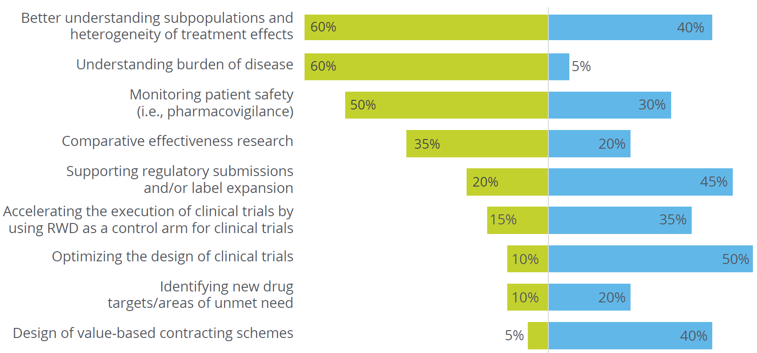
Industry: Desired future use of RWE
?
Please rank the three most impactful areas of current and future RWE application within your organisation
Source: Deloitte’s 2018 RWE Benchmarking Survey, p. 8, n=20
Note: The percentage denotes current and future application areas ranked amongst the top three by respondents and expressed as a percentage

Slide 11
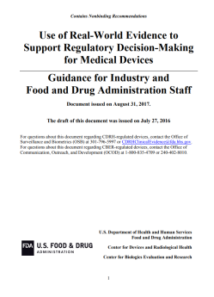
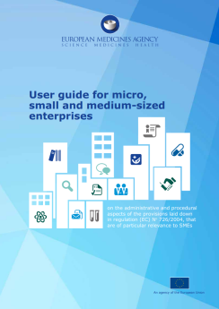
Current guidelines on RWE are limited and mostly focused on devices and areas of high unmet need
U.S. Food and Drug Administration
European Medicines Agency
24 pages guidance¹ for medical devices
92 pages guidance² applying primarily to treatments in areas of high medical need where it is difficult to collect data via traditional routes
Ongoing guidance development: FDA’s pre- and post-market requirements for ‘How can real world evidence (RWE) better support regulatory decisions’?
EMA is committed to enabling early patient access to new medicines
1. FDA: Use of Real-World Evidence to Support Regulatory Decision-Making for Medical Devices, Guidance for Industry and Food and Drug Administration Staff, 2017
2. EMA: User guide for micro, small and medium-sized enterprises on the administrative and procedural aspects of the provisions laid down in regulation (EC) No 726/2004, that are of particular relevance to SMEs

Slide 12
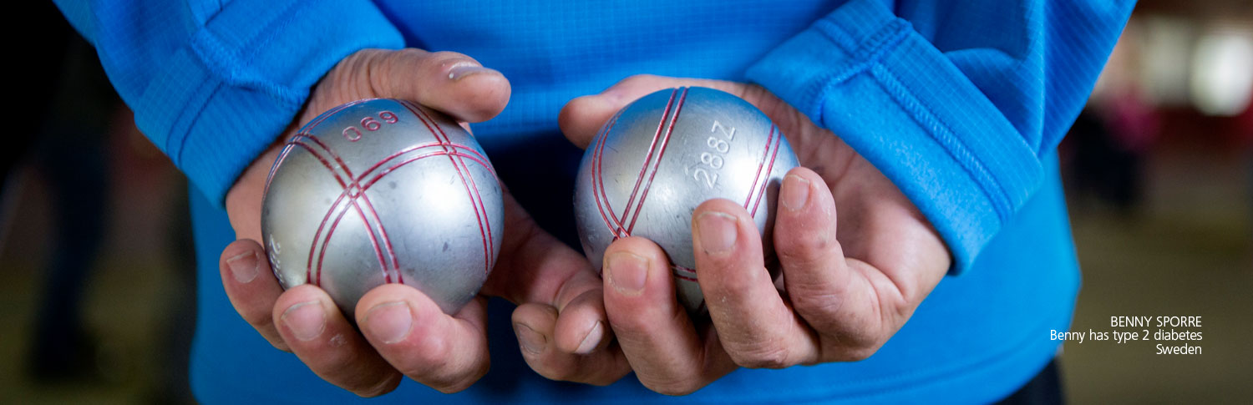
Potential regulatory uses of
RWE study design / evidence collection
PASS – Post-authorisation safety surveillance studies (CVOT)
Comparative efficacy versus other standards of care
Broader populations versus RCT studies
Safety in special populations (elderly, renal compromise)
Combination therapy (safety and efficacy)

Slide 13
Increased collaboration must exist between stakeholders
Ensure all stakeholders are engaged – early dialogue
Develop a common understanding and definition of the terminology
Reach consensus regarding the relevance of RWD/RWE for answering different scientific questions
Harmonise evidence requirements during different drug development and assessment phases
Standardise and provide guidance on tools, methodologies and strategies for RWD collection and analysis

Slide 14
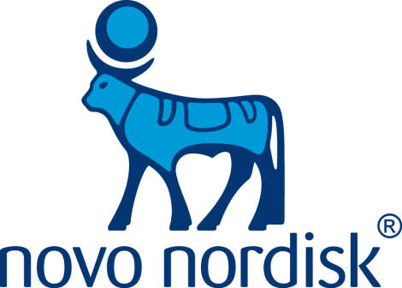
The Apis bull logo is a registered trademark of Novo Nordisk A/S

