Slide 1

HMA-EMA Joint Big Data Taskforce – challenges, mapping and next steps
Dr Alison Cave
On Behalf of the HMA-EMA Joint Big Data taskforce

Slide 2
Disclaimer
The views expressed in this presentation are my personal views and may not be understood or quoted as being made on behalf of or reflecting the position of the European Medicines Agency or one of its committees or working parties.

Slide 3

Structure
Current and Future Regulatory Landscape
Can data bridge the gap?
HMA-EMA Joint Big data taskforce – mandate
What is big data?
Deriving actionable evidence
Conclusions and next steps

Slide 4

Current Regulatory Landscape
Multiple challenges in the use of RWD
Non clinical models fail to mirror human disease
Increased reporting of ADRs
Monitoring the impact of risk minimisation measures
Long term validation of digital/ surrogate endpoints
Patient access to new medicines
Unknown generalisability of RCTs
Limited size of clinical database at approval
B/R in special and high risk populations
Pre-authorisation
Authorisation
Post authorisation

Slide 5

Future Regulatory Challenges
Increasingly complex trial designs
Greater use of RWD across the product life cycle
Growth in biomarker use
Increasing disease stratification/personalised medicine
Increasing numbers of products unable to align with traditional drug development pathway
Greater use of modelling and simulation approaches
Increased incorporation of composite endpoints/ Patient reported outcome measures
Greater development of preventative medicines
More combination therapies
Personalisation of dose and risk profiles
Incorporation of patient preferences into decisions
Pre-authorisation
Authorisation
Post authorisation

Slide 6




How can we bridge the gap?
?
Data driven evidence

Slide 7
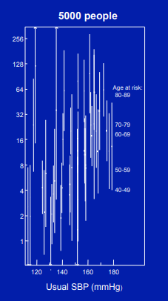
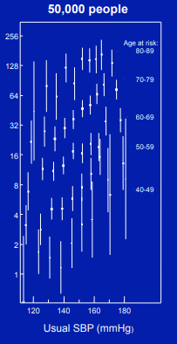
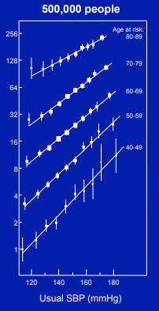
How can large volumes of data support decision making?
Ischaemic Heart Disease versus SBP for 5K vs 50K vs 500K people in the Prospective Studies Collaboration (PSC)
IHD mortality
(floating absolute risks and 95% CI)
IHD mortality
(floating absolute risks and 95% CI)
IHD mortality
(floating absolute risks and 95% CI)
Professor Rory Collins https://www.ctsu.ox.ac.uk/research/psc

Slide 8
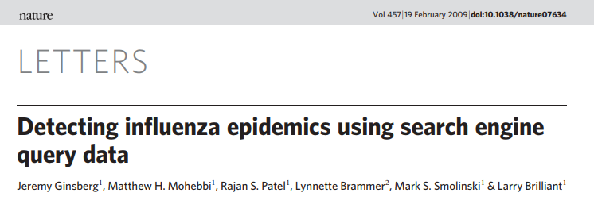

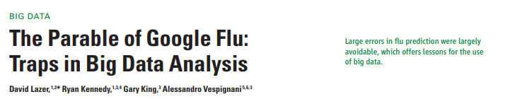
…….But we need to be careful
Large data volumes may increase precision of measurements – but not necessarily accuracy
Transparency, replicability, validation

Slide 9
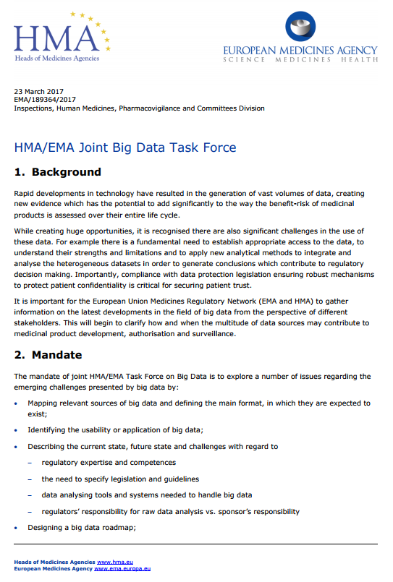

HMA-EMA Joint Big Data Taskforce
The Task Force should characterise relevant sources of big data and define the main format, in which they can be expected to exist in
Identify areas of usability and applicability of data
Gap analysis – describe the current status of expertise, future needs and challenges
The Task Force will generate a list of recommendations and Big Data Roadmap

Slide 10
What is Big Data ?
          Extremely large – Volume
          Complex and multi-dimensional – Variable
          Unstructured and heterogeneous – Variety
          Accumulating rapidly – Velocity
          What do we need?
          ………an answer within reliable constraints – Value

Slide 11
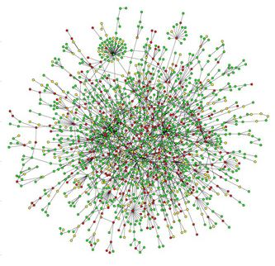
BIG DATA
Bioanalytical omics
Clinical trial data
Social media/ m health
ADR data
Genomics
Data Analytics subgroup
Report end of Q1 2019
Observational data

Slide 12
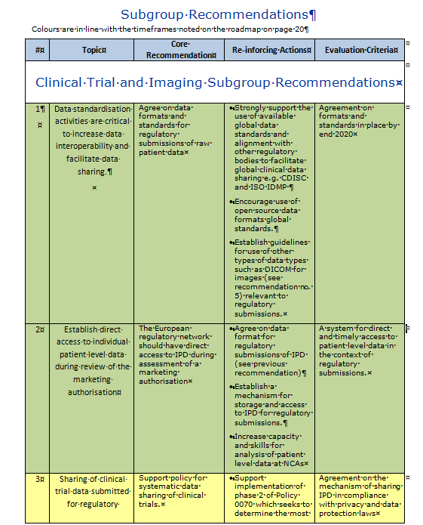
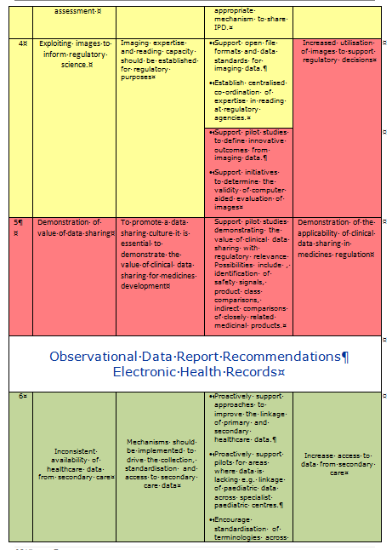
Taskforce has delivered 6 individual reports and detailed tables of prioritised recommendations from each subgroup

Slide 13
Defining Regulatory acceptability
Regulatory acceptability
Big Data

Slide 14
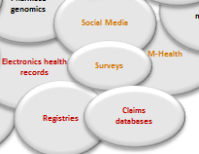
RWD is part of the big data landscape
Epigenetics
Transcriptomics
Genomics
Proteomics
Functional Phenotypes
Metabolomics
Lipodomics
RCTs
Pharmaco genomics
In silico modelling
RWD
Social Media
Structural biology
Electronics health records
M-Health
Surveys
Environmental data
Registries
Claims databases

Slide 15
Case study
Control Arm Substitutions
Yescarta /Kymriah
CD19 directly modified autologous T cell immunotherapies
Refractory or relapsed DLBCL
Pivotal trials: Yescarta - Single arm study ZUMA-1/ Kymriah - single arm C2201
Solution: pooled analysis of outcomes in refractory aggressive NHL selected from Phase III RCTS and observational cohorts to provide confirmation of the pre-specified control response rate and historical context for interpreting single arm results.
Why?
Rare disease
Unmet medical need
RCT unfeasible
Actionable outcome captured in the data

Slide 16
Case Study
Registry data for historical controls
Zalmoxis
Adjunctive treatment in haploidentical haematopoietic stem cell transplantation (HSCT) of adult patients with high-risk haematological malignancies.
Pivotal trial – single arm Phase I/II study with a surrogate endpoint of immune reconstitution + on-going Phase III trial.
The EBMT patient registry was used to compile an appropriate control group selected on same criteria as the control arm of the on-going Phase III trial and a specific set of matching parameters
Why?
Rare Disease
Unmet medical need
Actionable outcome captured in the data
Significant delay in capturing other data

Slide 17
Case Study
Registry data for extension of indication
Eculizumab (Solaris)
Paroxysomal nocturnal haemoglobinuria (PNH) in a restricted patient population with a prior history of transfusions
MAH wished to extend the indication to patients without a prior history of infusions.
A global PNH registry across all stages of disease was utilised to provide data to support the extension of the indication
Why?
Rare Disease
Unmet medical need
Availability of a global registry which included patients treated or not treated with eculizumab
Efficacy of eculizumab meant a prospective RCT requiring a non treatment group not possible

Slide 18
RWD is a critical part of the pharmacovigilance data landscape
1,104.127
Eudravigilance Annual Report 2017
Many validated signals required further evidence to define and understand.
RWD forms part of this jigsaw.
2,062
2.1%
Limited opportunity to capture data.
Multiple sources of evidence of varying quality from multiple stakeholders are balanced to inform decision making.
43
ADR Reports
(Centralised)
Signals
Detected
Validated
Signals

Slide 19




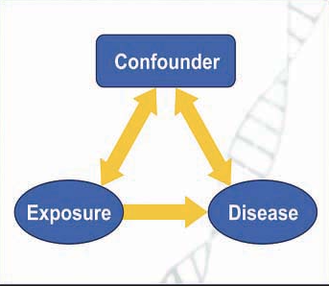

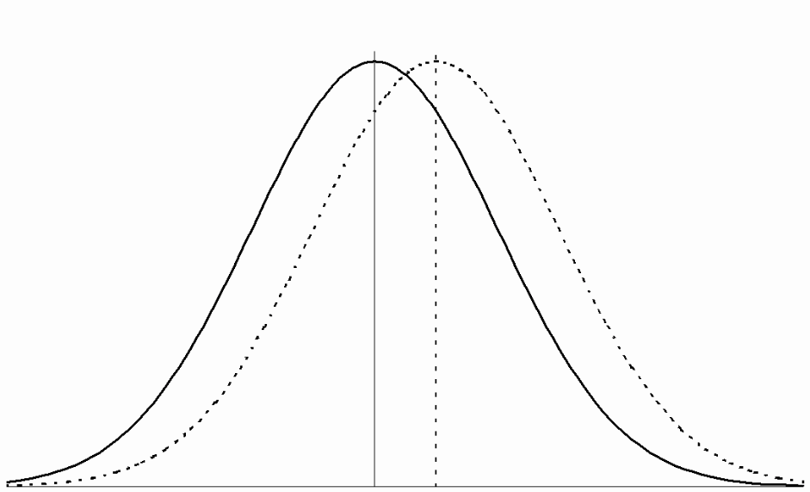


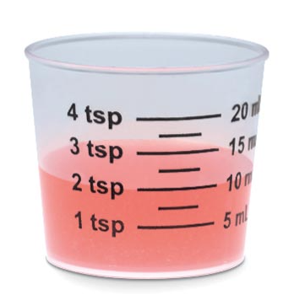
Unmet need
Delay imposed by generating other data
Regulatory setting in which the evidence will be used
Feasibility of capturing other data
Methodology to control for confounding
and bias
No one single answer
Acceptability of RWD
Actionable outcome
What is already known about B/R?
Is the effect size discernable?
Ability to record exposure, dose, duration and adherence
Precise biomarkers of disease or diagnostic markers likely to be recorded
Understanding of disease progression

Slide 20

How do we navigate the maze?

Slide 21
Regulatory Challenges | Examples
Operational | Timely data access to data sources across national borders, quality assurance processes, transparency of reporting, development of sustainable infrastructures, data privacy and ethical considerations
Technological | Coding systems, terminologies, data formats, quality, data linkage, scope and content
Methodological | Management of biases, confounding, missing data, interpretation of heterogeneous results, feasibility analysis, validation of data sources and new methodological approaches eg common data model

Slide 22
How do we navigate the maze?
Define the key parameters to be considered in both designing and assessing a study to enhance the quality of evidence generated and the consistency of regulatory decision making

Slide 23





Consistency
Adequate
Criteria for Acceptability
Transparency
Sustainability
Accessibility

Slide 24
What does the regulatory network need?
timely access to data that is high quality, is actionable and relevant for benefit-risk assessment, which supports multiple use cases, is representative of Europe, of sufficient quality and generated in through a transparent methodology and is delivered through a platform with robust data governance

Slide 25
Conclusions
Big data offers the possibility to derive novel insights to support decision making but also brings unknowns around data quality and hence the robustness of the evidence generated
A regulatory strategy is required now to determine how and when in the product life cycle the utilisation of such data can bring value
Importantly we need to build capacity and expertise across the regulatory network
Defining exact evidentiary standards a priori is difficult as necessary standards will vary depending on the context of use.
There is a need for guidance on the key parameters which need to be considered in both designing and assessing a study to enhance the quality of evidence generated and the consistency of regulatory decision making.
There is an urgent need to consider the data needs for the future, to consider the scope, depth and quality of data that will be required to enable generation of reliable evidence by design suitable for a broad range of regulatory use cases.

Slide 26
Membership of HMA/EMA Joint Task Force on Big Data
Chairs
Nikolai Brun (DKMA)
Alison Cave (EMA)
Members (taskforce and subgroups)
Aldana Ross (DK)
Paolo Alcini (EMA)
Gianmario Candore (EMA)
Zsuzsanna Cserjés Szabone (Hu)
Dieter Deforce (BE)
Katherine Donegan (UK)
Roxana Dondera (RO)
Gavril Flores (MT)
Per Fuglerud NO (until June 2017)
Mark Goldammer (DE)
Kevin Horan (IE)
Antti Hyvarinen (FI)
Vesa Kiviniemi (FIMEA)
Cesar Hernandez Garcia (ES)
Renate König (PEI)
Marc Lehmann (EMA)
Miguel Angel Macia (ES)
Didier Meulendijks (CBG-MEB)
Randi Munk-Jacobsen (DKMA)
Martin Nyeland (DKMA)
Marjon Pasmooij (CBG-MEB)
Alexandra Pacurariu (EMA)
Luis Pinheiro (EMA)
Hans Ovelgönne (CBG-MEB)
Mateja Sajovic (SI)
Roxana Stroe (RO)
Panagiotis Telonis (EMA)
Secretariat: Randi Munk-Jakobsen (Tina Engraff)

Slide 27

Thank you for your attention
Further information: alison.cave@ema.europa.eu
European Medicines Agency
30 Churchill Place • Canary Wharf • London E14 5EU • United Kingdom
Telephone +44 (0)20 3660 6000 Facsimile +44 (0)20 3660 5555
Send a question via our website www.ema.europa.eu/contact
Follow us on @EMA_News

Slide 28






Data strategy
components underpinning acceptability
Data Standardisation
Data Quality
Skills and knowledge
Communication & Engagement
Data Sharing and Access
Data Linkage
Data Analytics

Slide 29
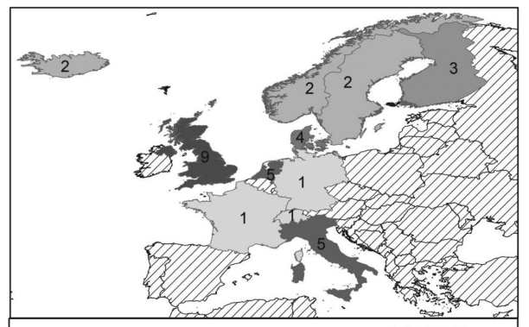
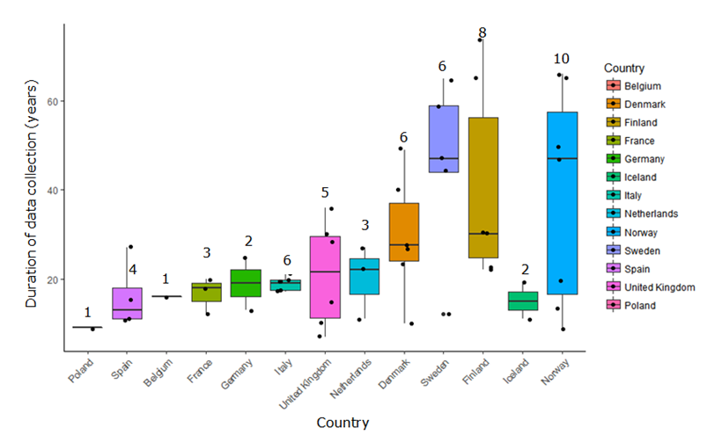
Limited representativeness across Europe
Only 13 member states have electronic health databases suitable for regulatory decision making
Bazelier et al, 2015
Limited number of European countries contributing to multi-database studies
Pacurariu et al, BMJ Open, 2018

Slide 30
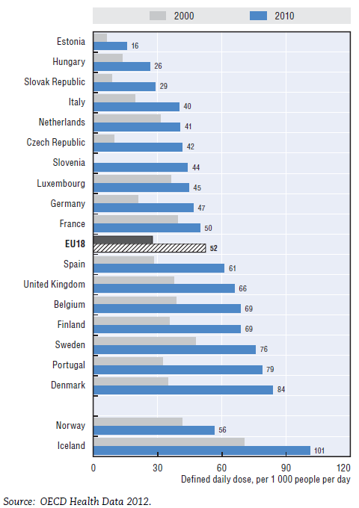
Different Prescribing Rates and Practices Across Europe
Prescribing of antidepressants varies widely between
European countries despite no evidence of difference in the
prevalence of affective disorders.
Antidepressants consumption
2000 and 2010
Critical to have access to data representative of the European population.

